Slide 1
Software Engineering and Architecture
Multi Dimensional Variance
Ultra flexible software

Slide 2
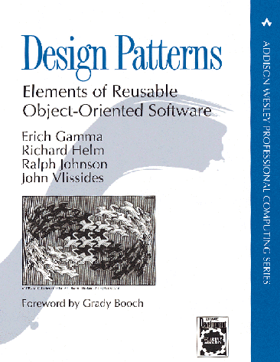
Goal and means to an end?
Patterns:
Goal in itself or just the means to an end?
Patterns are interesting as means to achieve some specific quality in our software:
elements of Reusable ...
A key aspect is handling variance

Slide 3
Variance
Factoring out in roles and delegating to objects that play roles is a very strong technique to handle multiple dimensions of variance!
that is – a piece of software that must handle different types of context
work on both MariaDB and MongoDB database
work in both testing and production environment
work both with real hardware attached or simulated environment
work with variations for four different customers
Here all types of combinations are viable !

Slide 4
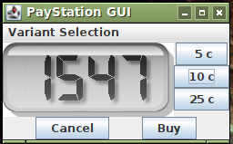
New Requirements
Alphatown county wants the display to show parking end time instead of minutes bought!
I.e “Parking ends at 15:47”

Slide 5
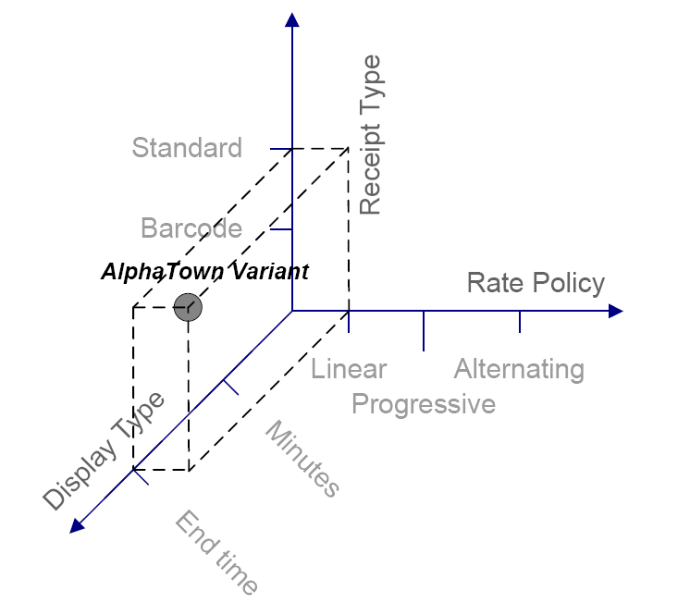
Combinatorial explosion!
All these requirements pose a combinatorial explosion of variants ☹
There are 3*2*2 = 12 combinations. This may be doubled if we include
overriding weekend day algorithm !

Slide 6
Restating the Options

Slide 7
Parametric Variance
Variant handling by if (param) or #ifdef’s is well known, but the code simply bloats with conditional statements.
Example: GNU C compiler has a single statement that includes 41 macro expansions !!!
I wonder what that code does???
#ifdef ( MSDOS && ORACLE || MYSQL && …)
#ifdef ( DEBUG )
quickly you loose control of what is going on…

Slide 8
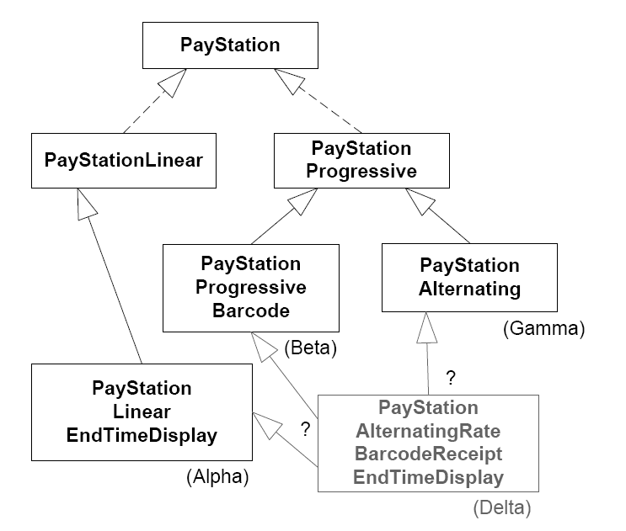
Polymorphic Variance
Inheritance dies miserably facing this challenge!
Just look at names!
Making new variants is difficult.
And code reuse is very difficult ☹

Slide 9
Masking the problem
By combining parametric and polymorphic variance you may mask the problem somewhat.
I.e. handle receipt type by inheritance, and the rest by pumping the code with if’s…
but … it is still an inferior way to handle multi-dimensional variance…

Slide 10
Compositional software
The way forward is:
Compositional software
Highly configurable and flexible software!
③ Consider what behavior that may vary
① Express variable behavior as a responsibility clearly defined by an interface
② Delegate to object serving the responsibility to perform behavior

Slide 11
③ ① ②
③ Encapsulate what varies
The display output must exist in variants
① Program to an interface
<<interface>> DisplayStrategy
public int calculateOutput( int minutes );
② Favor object composition

Slide 12
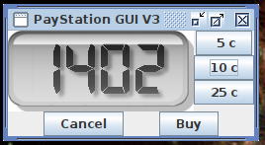
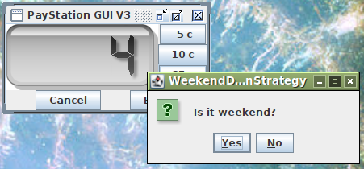
Compositional software
[Demo]
Notes:
Frsproject/paystation-many-to-many

Slide 13
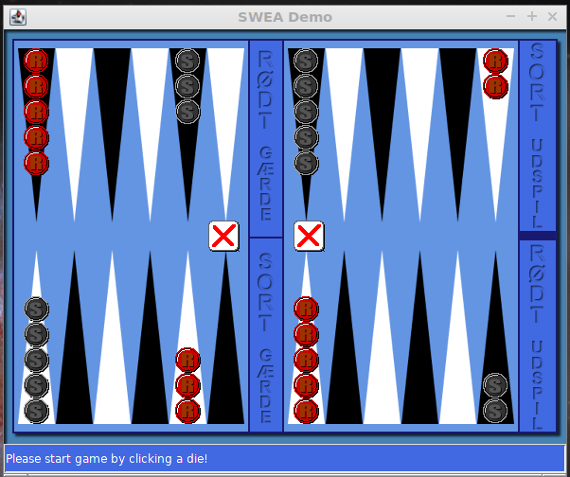
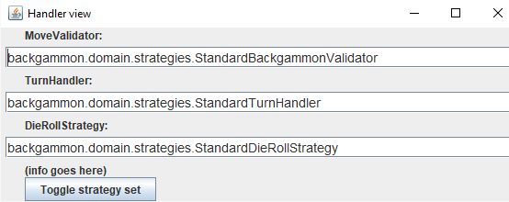
Compositional Software
[Backgammon Demo]

Slide 14
Compositional Software
The paystation has become a team leader, delegating jobs to specialist workers:
Note! No if’s – no bloat – easy to read code leading to fewer bugs!

Slide 15
Compositional Software
Telling the team leader which persons will serve the roles:
The factory interface

Slide 16
Compositional Software
Creating a pay station:
create the factory
create the pay station, giving it access to the factory

Slide 17
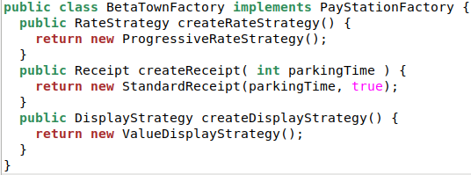
Compositional Software
... and a factory:

Slide 18
Analysis
Benefits
The variability points are independent
we introduced new display strategy – but this did not alter any of the existing strategies !
Once the variability point has been introduced we can introduce as many new types of variations as we like – only by adding new classes
any price model; new receipt types; new display output...
Open-closed principle in action...
public int readDisplay() {
return displayStrategy.calculateOutput(timeBought);
}
Notes:
open to extension /

Slide 19
Open/Closed principle
Open for extension
Closed for modification

Slide 20
Open/Closed principle
Open for extension
I can make my own feature additions/changes by extending the software
Closed for modification
But I do not rewrite any existing code
Or ask Oracle, Google, NetFlix, Apache, to rewrite code to handle my extensions
(i.e. no soldering of wires in my TV set)

Slide 21
Analysis
Benefits
Any combination you want, we are able to “mix”
Nonsense combinations can be delimited
abstract factory is the place to “mix” the cocktails
Code readability
every aspect of the configuration is clearly defined in a single place
configuration mixing in the abstract factory
orchestration in the PayStation impl
each variation type in its own implementing class

Slide 22
Analysis
Liabilities
Each dimension of variability (price model, receipt type, display output, etc) is really independent – so
we cannot feed information from one to the other directly ☹
If they require information from each other
Then of course we must provide the means to do so
Mediator pattern, memento pattern, observer pattern, others
Like we do in mandatory project
StandardGame calls strategy with ‘this’ ala a Private Interface
The Strategy calls mutators on the MutableGame

Slide 23
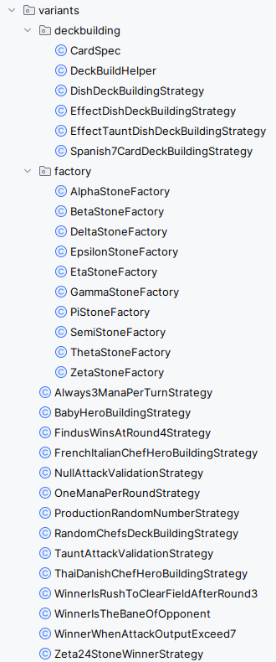
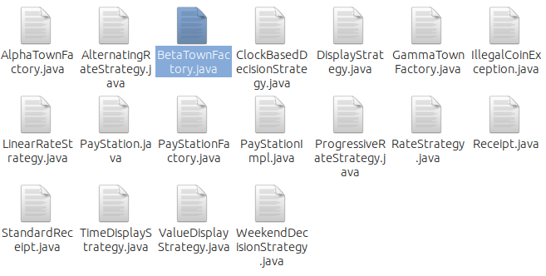
Analysis
Liabilities
The number of classes in action ☹
On the other hand:
careful naming makes it possible to quickly identify which class to change…
And use packages to group cohesive modules

Slide 24
Analysis
Liabilities
Actually I have a combinatorial explosion of factories! I need a factory for each and every combination of delegates that I have
Exercise: How can I avoid this explosion?

Slide 25
Another Example
SkyCave

Slide 26
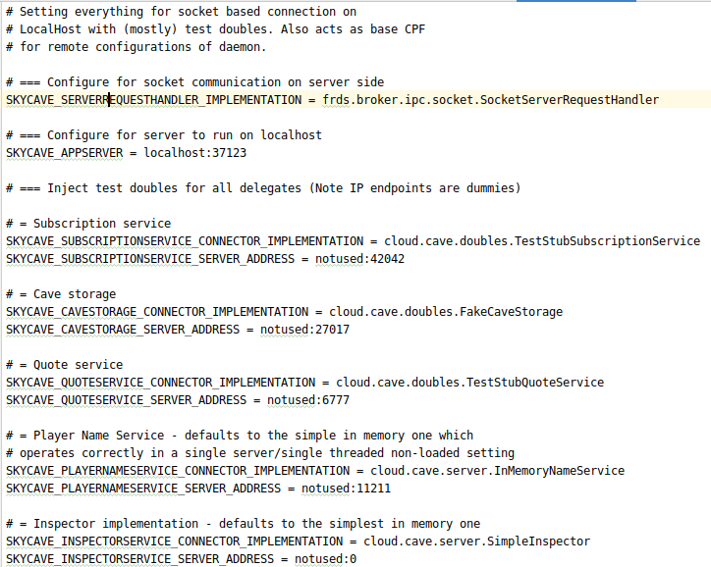
Configuration System
Six roles of variability
Storage system
Network connector
Authentication
External services
Name Service
Logging System
AbsFactory reads a CPF property file
Impl class
Network host and port

Slide 27
Configuration System
Six roles of variability
Storage system (5)
FakeObject, MongoDB, Redis, Memcached, MariaDB
Network connector (3)
Sockets, HTTP, RabbitMQ
Authentication (3)
TestStub, NullObject, RealService
External services (2)
TestStub, RealService
Name Service (2)
In memory, Memcached
Logging System (2)
In memory, Memcached
SkyCave can exist in 5*3*3*2*2*2 = 360 variants

Slide 28
And No Code Clutter
An object manager keeps track of all delegates ☺

Slide 29
Summary
Handle multi-dimensional variance by compositional software designs !

